Slide 1
EGRE 206 Electric circuits
Chapter 3 – Analytical Techniques

Slide 2
Overview

Slide 3
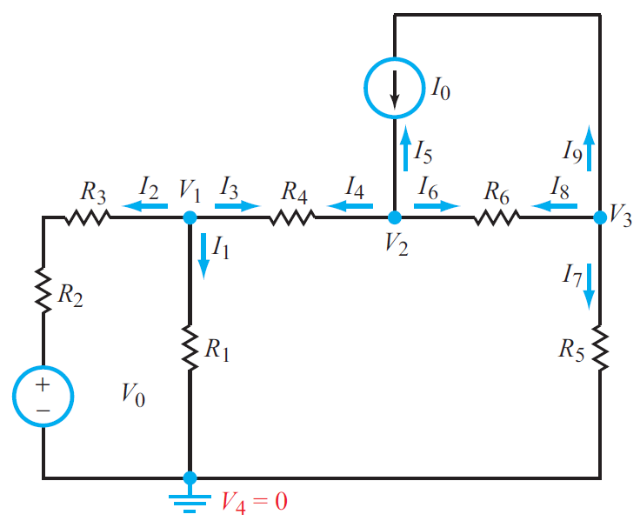
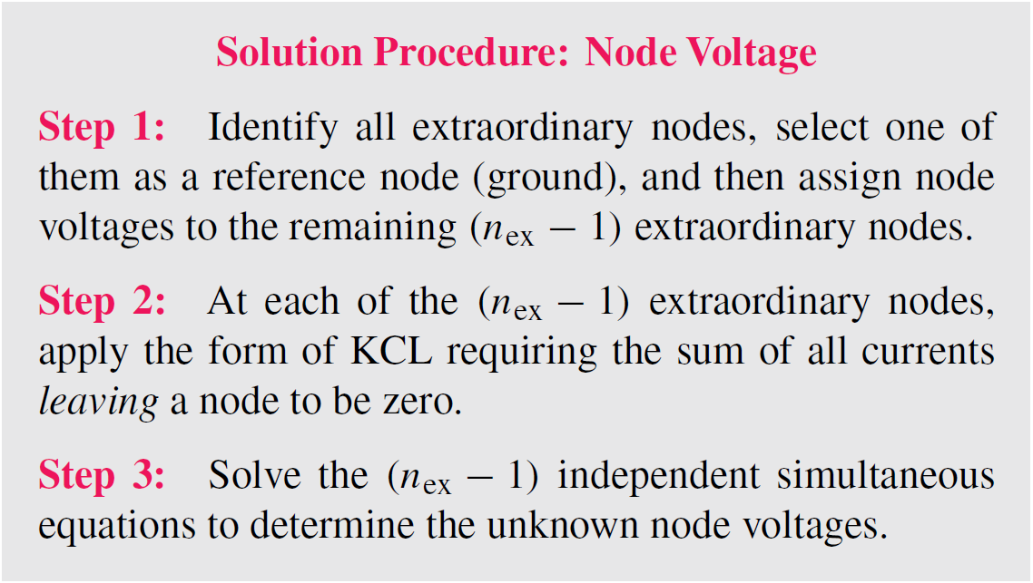
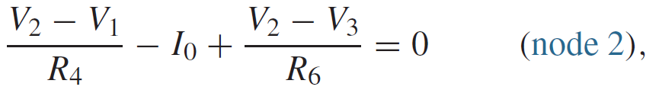

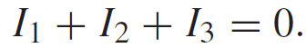
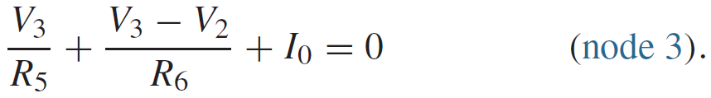
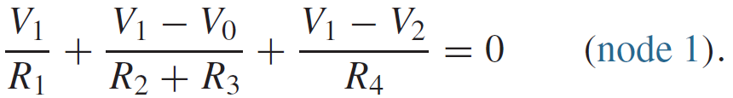
Node-Voltage Method
Node 1
Node 3
Node 2
Node 2
Node 3

Slide 4
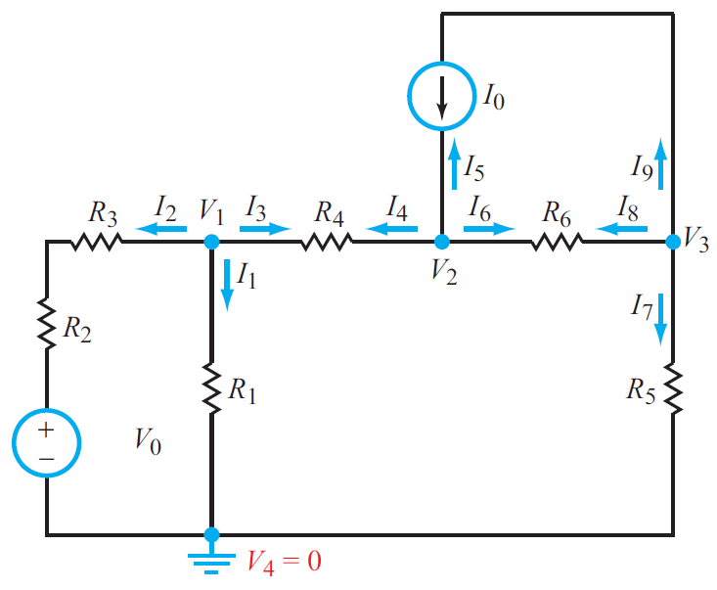
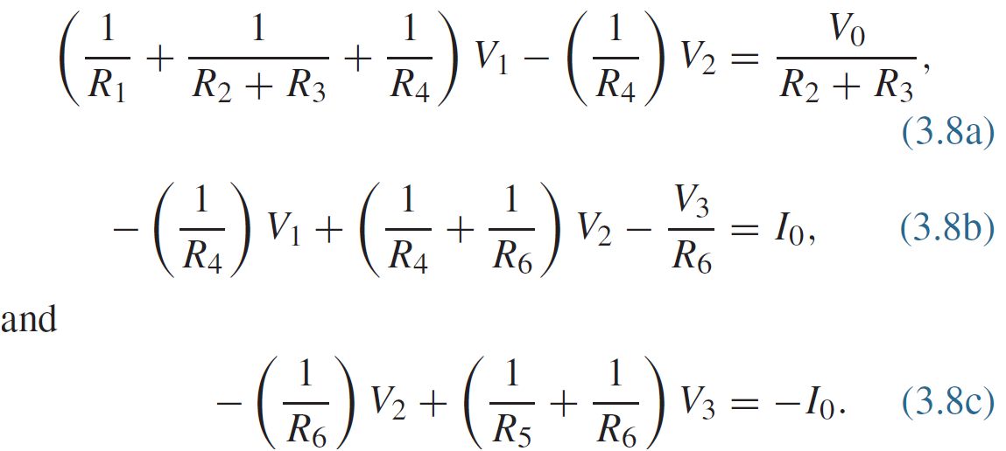
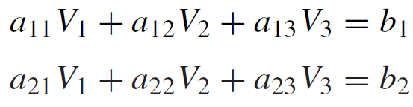
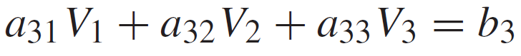
Node-Voltage Method
Three equations in 3 unknowns:
Solve using Cramer’s rule, matrix
inversion, calculator or MATLAB

Slide 5
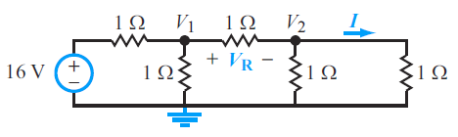
Node-Voltage Method (Example 1)
Use nodal analysis to determine the voltages, V₁ and V₂, in the circuit below. Then find V_{R} and I

Slide 6
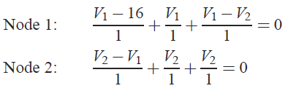
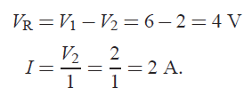
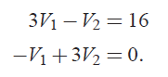
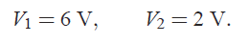
Use nodal analysis to determine the voltages, V₁ and V₂, in the circuit below. Then find V_{R} and I
Simplifying:
Solving for V₁ and V₂:

Slide 7
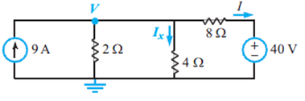
Node-Voltage Method (Example 2)
Use nodal analysis to determine the current, I_{x}, and amount of power supplied by the voltage source in the circuit below

Slide 8
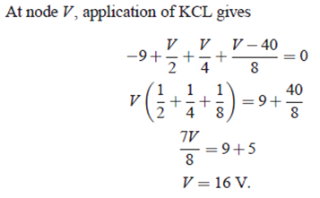
Use nodal analysis to determine the current, I_{x}, and amount of power supplied by the voltage source in the circuit below

Slide 9
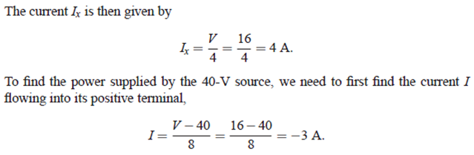
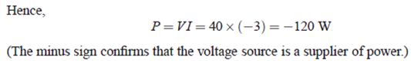
Use nodal analysis to determine the current, I_{x}, and amount of power supplied by the voltage source in the circuit below

Slide 10
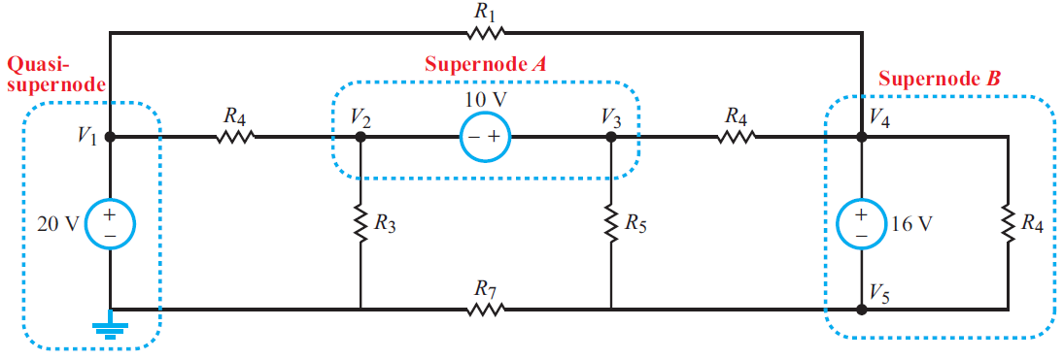
Supernode
A supernode is formed when a voltage source connects two extraordinary nodes
Current through voltage source is unknown
Less nodes to worry about, less work!
Write KVL equation for supernode
Write KCL equation for closed surface around supernode

Slide 11
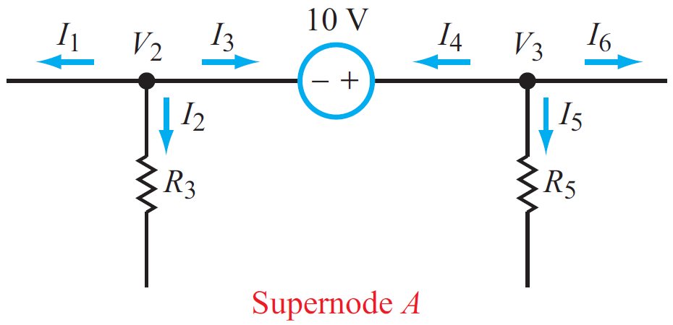
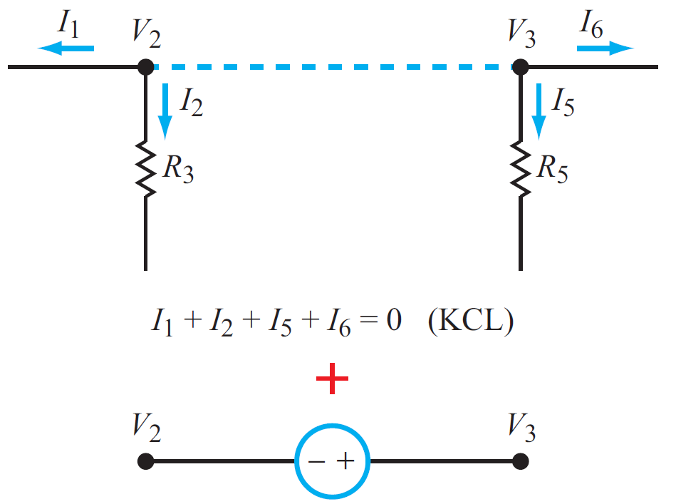
KCL at Supernode
=
Note that “internal” current in supernode cancels, simplifying KCL expressions
Takes care of unknown current in a voltage source

Slide 12
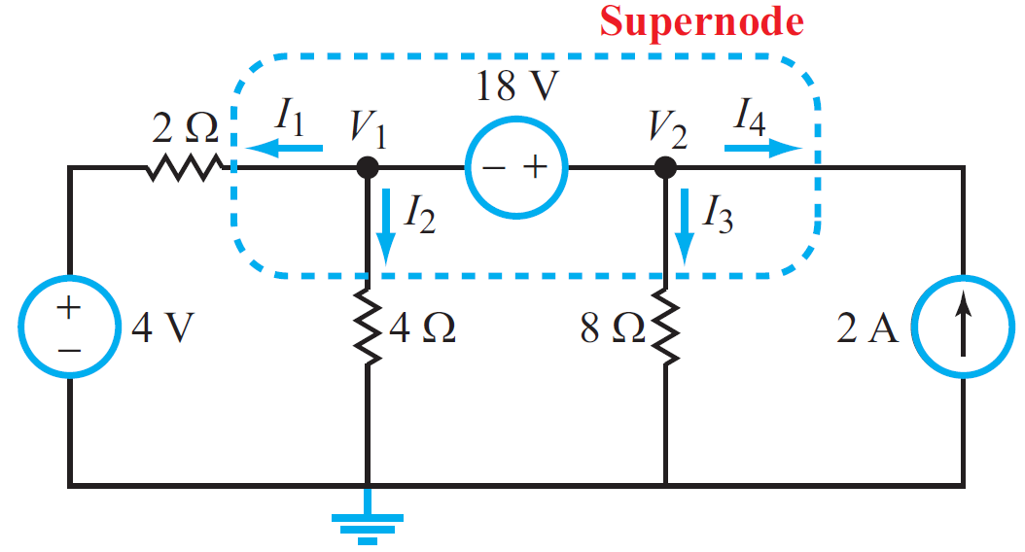
Example 3 (N-V with Supernode)
Determine: V₁ and V₂

Slide 13
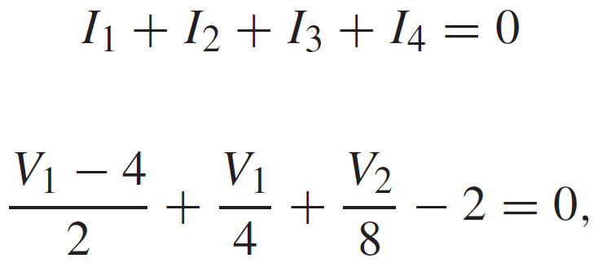
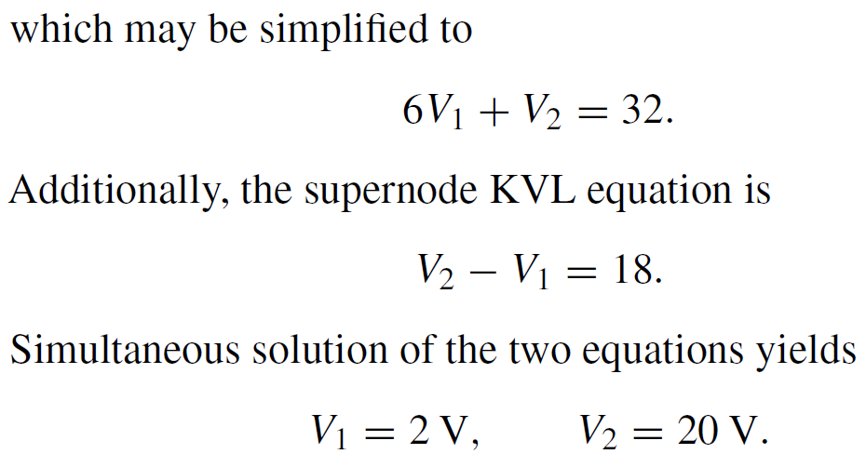
Example: Supernode
Solution:
Supernode
Determine: V1 and V2

Slide 14
EGRE 206 Electric circuits
Chapter 3.2 Mesh Current and Supermesh

Slide 15
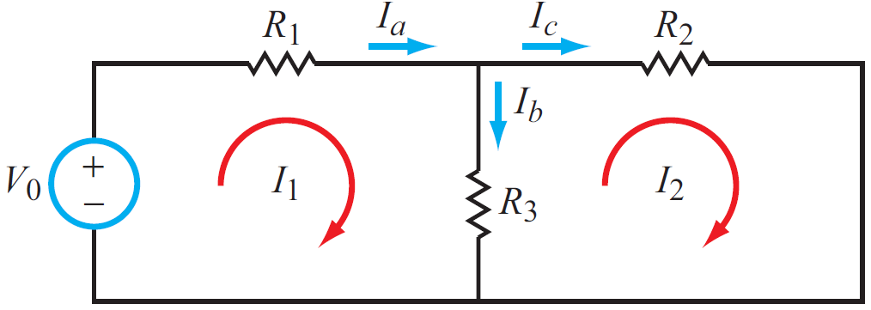
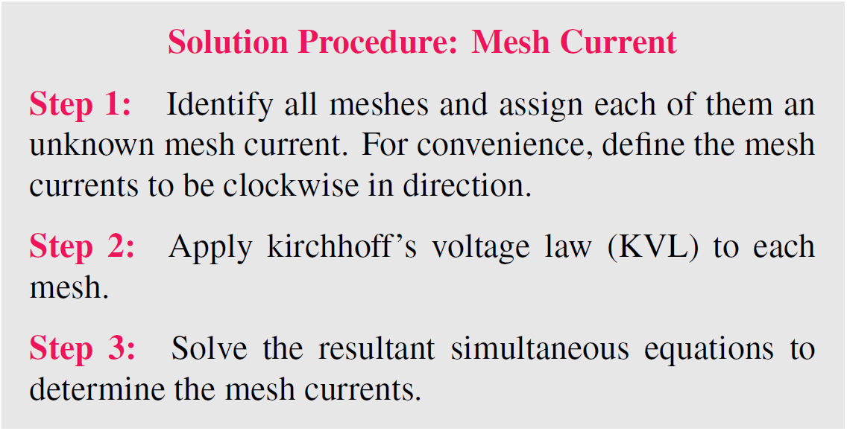
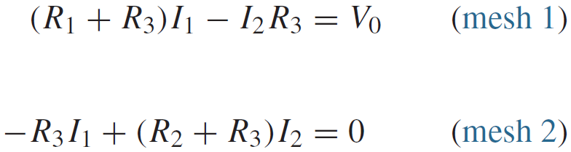
Mesh-Current Method
Two equations in 2 unknowns:
Solve using Cramer’s rule, matrix inversion, or MATLAB

Slide 16
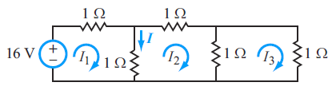
Example 4: Mesh-Current
Find the current I in the circuit below

Slide 17
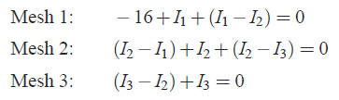
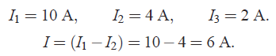
Example 4: Mesh-Current
Find the current I in the circuit below

Slide 18
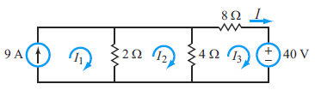
Example 5: Mesh-Current
Determine the amount of power supplied by the voltage source, using Mesh-Current Analysis

Slide 19
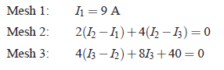
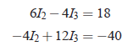
Example: Mesh-Current
Determine the amount of power supplied by the voltage source, using Mesh-Current Analysis

Slide 20
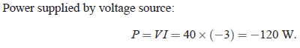
Example 5: Mesh-Current
Determine the amount of power supplied by the voltage source, using Mesh-Current Analysis

Slide 21
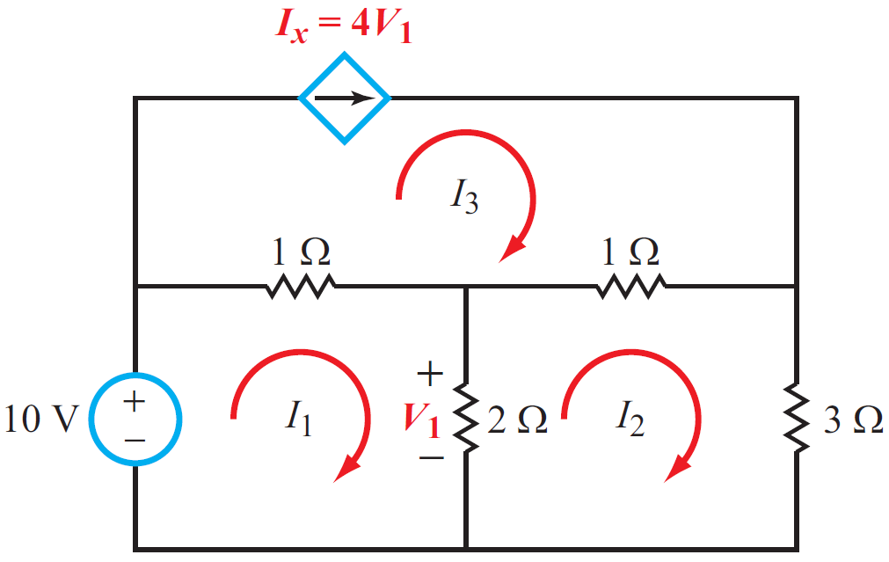
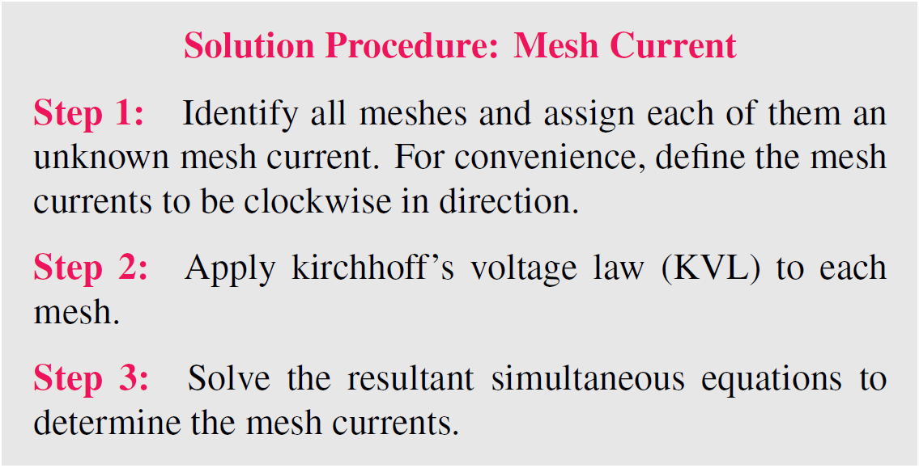
Example 6: With dependent source

Slide 22
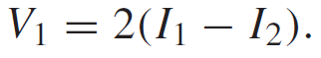
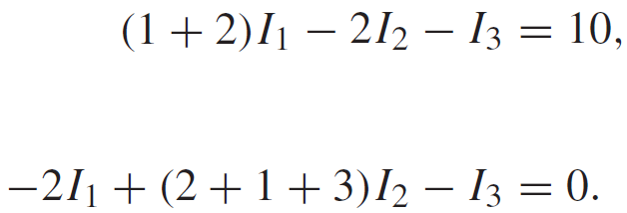
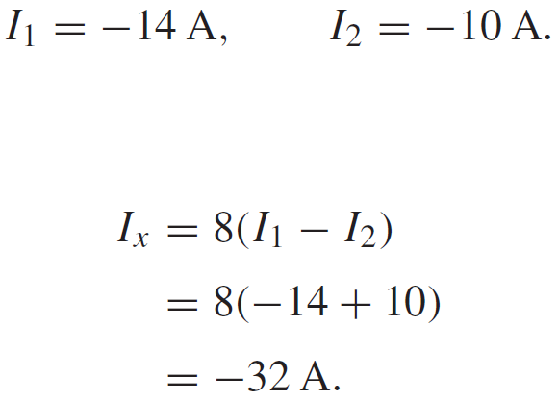
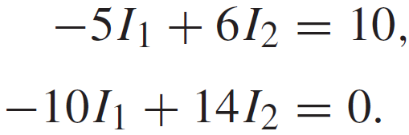
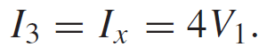
Example 6: With dependent source
But
Mesh 1
Hence
Mesh 2
Mesh 3

Slide 23
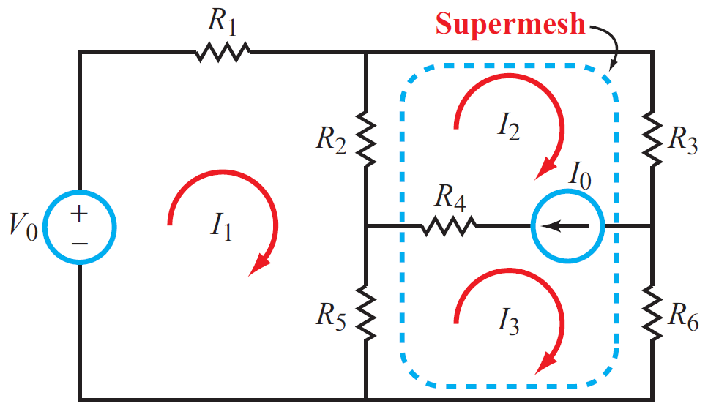
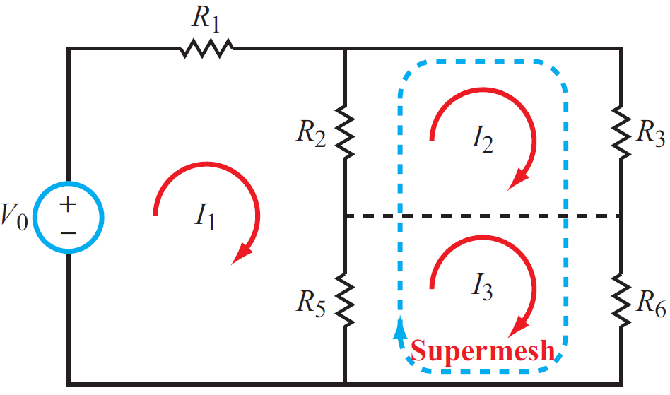
Supermesh
A supermesh results when two meshes have a current source( with or w/o a series resistor) in common
Voltage across current source is unknown
Write KVL equation for closed loop that ignores branch with current source
Write KCL equation for branch with current source (auxiliary equation)

Slide 24
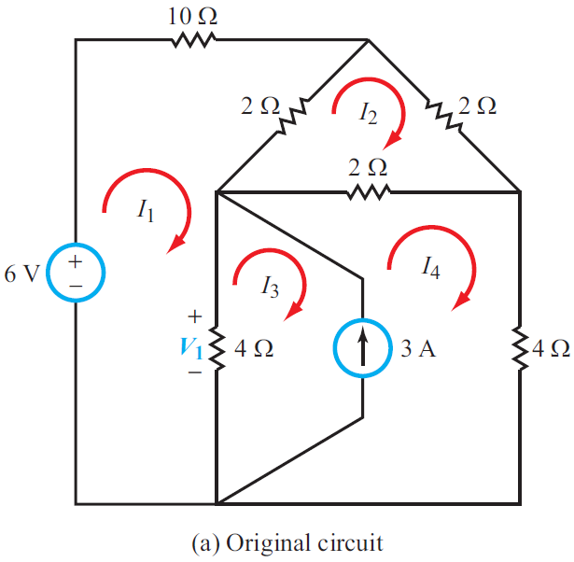
Example 7: Supermesh – Find V₁

Slide 25
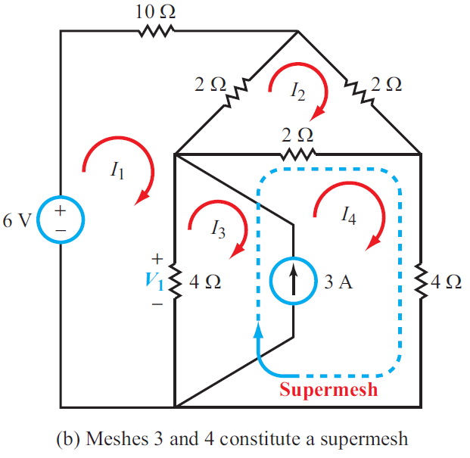
Example 7: Supermesh

Slide 26
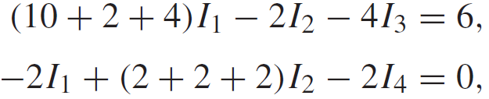
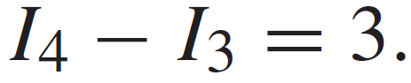
Example 7: Supermesh
Mesh 1
Solution gives:
Mesh 2
SuperMesh 3/4
Supermesh Auxiliary Equation

Slide 27
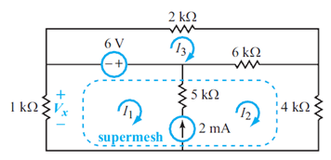
Example 8: Find V_{x} in the circuit below

Slide 28
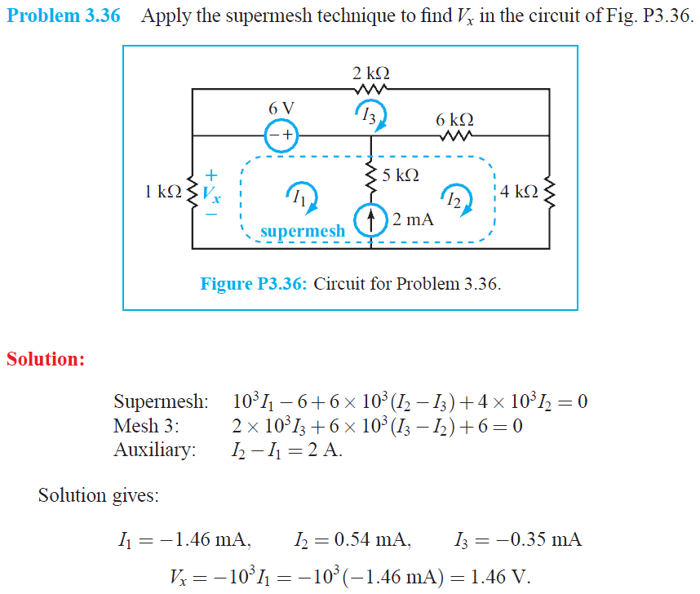

Slide 29
Nodal versus Mesh
When do you use one vs. the other?
What are the strengths of nodal versus mesh?
Nodal Analysis
Node Voltages (voltage difference between each node and ground reference) are UNKNOWNS
KCL Equations at Each UNKNOWN Node Constrain Solutions (N KCL equations for N Node Voltages)
Mesh Analysis
“Mesh Currents” Flowing in Each Mesh Loop are UNKNOWNS
KVL Equations for Each Mesh Loop Constrain Solutions (M KVL equations for M Mesh Loops)
Count nodes, meshes, look for supernode/supermesh

Slide 30
EGRE 206 Electric circuits
Chapter 3 – Section 4 (Superposition)

Slide 31
Linearity
A circuit is linear if output is proportional to input
A function f(x) is linear if f(ax) = af(x)
All circuit elements will be assumed to be linear or can be modeled by linear equivalent circuits
Resistors V = IR
Linearly Dependent Sources
Capacitors
Inductors
We will examine theorems and principles that apply to linear circuits to simplify analysis

Slide 32


Superposition

Slide 33


Superposition
Superposition trades off the examination of several simpler circuits in place of one complex circuit

Slide 34

Superposition
The sum of each individual response is the
total response for a given passive element. This response can be the sum of individual voltages or the sum of individual currents.

Slide 35
Example 9: Superposition
Contribution from I₀
alone
Contribution from V₀
alone
I₁ = I₀[R₁/(R₁+R₂)] = 2A
I₂ = -(45V / 15Ω) = ‒3A
I = I₁ + I₂ = 2 ‒ 3 = ‒1 A

Slide 36

Example 10: Superposition
Use Superposition to Find Ix (Ix = Ix’ + Ix”)
a. Find Ix due to the voltage source only (Ix’)
b. Find Ix due to the current source only (Ix’’)

Slide 37

Example 10: Superposition
Find Ix due to the voltage source only (Ix’)
Mesh 1: 7I₁’ – 2I₂’ = -48
Mesh 2: -2I₁’ + 12I₂’ = 48
I₁’ = -6A
I₂’ = 3A
I_{x}’ = I₂’ = 3A

Slide 38

Example 10: Superposition
Find Ix due to the current source only (Ix”)
Mesh 1: 7I₁” – 2I₂” – 3I₃” = 0
Mesh 2: -2I₁” + 12I₂” – 6I₃” = 0
Mesh 3: I₃” = -4A
I₁” = -2.4A
I_{x}” = I₂” – I₃”
= -2.4A – (-4A) = 1.6A
I₂” = -2.4A

Slide 39
Example 10: Superposition
Use Superposition to Find Ix (Ix = Ix’ + Ix”)
a. Find Ix due to the voltage source only (Ix’)
b. Find Ix due to the current source only (Ix’’)
I_{x}’ = 3A
I_{x} = I_{x}’ +I_{x}”= 4.6A
I_{x}” = 1.6A

Slide 40

Example 11: Superposition
Use Superposition to Find Ix (Ix = Ix’ + Ix”)
a. Find Ix due to the voltage source only (Ix’)
b. Find Ix due to the current source only (Ix’’)

Slide 41

Example 11: Superposition
Find Ix due to the voltage source only (Ix’)
Hint: Use Node Voltage Analysis:

Slide 42
Example 11: Superposition
Find Ix due to the voltage source only (Ix’)
I_{x}’ = V₁’ / 4Ω
= 10/7 A

Slide 43

Example 11: Superposition
Find Ix due to the current source only (Ix”)
Hint: Use Node Voltage Analysis:

Slide 44
Example 11: Superposition
Find Ix due to the current source only (Ix”)
I_{x}’ = V₁’’ / 4Ω
= 18/7 A

Slide 45
Example 11: Superposition
Use Superposition to Find Ix (Ix = Ix’ + Ix”)
a. Find Ix due to the voltage source only (Ix’)
b. Find Ix due to the current source only (Ix’’)
I_{x}’ = 10/7 A
I_{x} = I_{x}’ +I_{x}”= 28/ 7 = 4A
I_{x}” = 18/7A

Slide 46
Example 11: Superposition
Can we use Superposition to Find P_{4Ω}, the power dissipated
in the 4Ω resistor? (P = P’ + P” ?)
c. Find P’, power dissipated from Ix’
d. Find P’’, power dissipated from Ix’’
I_{x}’ = 10/7 A
I_{x}” = 18/7A
Recall: P = IV = I²R = V²/R
I_{x} = 4A

Slide 47
Example 11: Superposition
Can we use Superposition to Find P_{4Ω}, the power dissipated
in the 4Ω resistor? (P = P’ + P” ?)
c. Find P’, power dissipated from Ix’
d. Find P’’, power dissipated from Ix’’
I_{x}’ = 10/7 A
P’ = (10/7)² (4) = 8.16W
P’’ = (18/7)² (4) = 26.45W
I_{x}” = 18/7A
I_{x} = 4A
P = (4)² (4) = 64W

Slide 48
Example 11: Superposition
Can we use Superposition to Find P_{4Ω}, the power dissipated
in the 4Ω resistor? (P = P’ + P” ?)
NO!
Superposition does NOT apply to Power!
(It is NOT linear)
P’ = (10/7)² (4) = 8.16W
P’’ = (18/7)² (4) = 26.45W
P ≠ P’ + P”
P = (4)² (4) = 64W

Slide 49
EGRE 206 Electric circuits
Chapter 3.5 (Thevenin and Norton Equivalent Circuits)

Slide 50

How do you design such a complex circuit?
Break it up into simpler “equivalent” circuits

Slide 51

Equivalent Circuit Representation (Amplifier)
V_{CC}
V_{S}
V_{out}
V_{CC}
Notes:
51

Slide 52
Equivalent Circuit Representation
Equivalent Circuit
V_{S}
V_{out}
Notes:
52

Slide 53

Equivalent Circuit Representation
This can be used with linear circuits
Simple equivalent circuits may be used to represent complex circuits
Notes:
53

Slide 54


Thévenin’sTheorem
Linear two-terminal circuit can be replaced by an equivalent circuit composed of a voltage source and a series resistor
voltage across output with no load (open circuit)
Resistance at terminals with all independent circuit sources set to zero

Slide 55
How Do We Find Thévenin/Norton Equivalent Circuits ?
THREE Different Methods can be used
Method 1: Open circuit/Short circuit
(Applicable on ANY circuit)
Method 2: Equivalent Resistance
(Applicable ONLY on circuits with NO dependent sources)
Method 3: External Source
(Applicable on ANY circuit)

Slide 56





How Do We Find Thévenin/Norton Equivalent Circuits ?
Method 1: Open circuit/Short circuit
1. Analyze circuit to find
2. Analyze circuit to find
Note: This method is applicable to any circuit, whether or not it contains dependent sources.

Slide 57

How many calculations needed?
In the circuit below, determine the magnitude and direction of current traveling through the load resistor, R_{L}, for the following values:
a. R_{L} = 6Ω
b. R_{L} = 18Ω
c. R_{L} = 30Ω
d. R_{L} = 114Ω
e. R_{L} = 234Ω

Slide 58
How many calculations needed?
In the circuit below, determine the magnitude and direction of current traveling through the load resistor, R_{L}, for the following values:
a. R_{L} = 6Ω
b. R_{L} = 18Ω
c. R_{L} = 30Ω
d. R_{L} = 114Ω
e. R_{L} = 234Ω
Rather than do 5 different problems, find the equivalent circuit between terminals a and b, and use that to find the current through R_{L}.

Slide 59
Example: Thévenin Equivalent
Find the Thevenin Equivalent Circuit between terminals a and b in the circuit below, using the Open Circuit/Short Circuit Method
Find V_{oc} (V_{oc} = V_{Th})
Find I_{sc}
Find R_{Th} = V_{Th} / I_{sc}

Slide 60


Find Open Circuit Voltage
Notes:
1. The voltage V_{c} is measured from that node to ground
2. There is NO current through the 2Ω resistor
a. There is no voltage across 2Ω resistor
b. The voltage at terminal a IS the voltage Vc
3. Terminal b is the same node as ground
The voltage V_{c} IS the voltage from terminal a to b (which is also V_{oc})

Slide 61
Find Open Circuit Voltage
Since V_{c} = V_{oc} = V_{Th}, we need to find V_{c}
Hint: Use Node Voltage Equation at V_{c}

Slide 62

Find Open Circuit Voltage
2V_{c} – 48 + V_{c} + 84 = 0
3V_{c} = -36
V_{c} = V_{oc} = V_{Th} = -12V

Slide 63

Find Short Circuit Current
Note:
1. Now there IS current through the 2Ω resistor
Use the same node-voltage technique to find I_{sc}

Slide 64


Find Short Circuit Current
2V_{c}‘ – 48 + V_{c} ‘ + 84 +6V_{c}’= 0
9V_{c}‘ = -36

Slide 65

Find Short Circuit Current

Slide 66
Find Thevenin Resistance
R_{Th} = (-12V) / (-2A) = 6Ω

Slide 67



Thévenin Equivalent Circuit

Slide 68



Norton’s Theorem
Linear two-terminal circuit can be replaced by an equivalent circuit composed of a current source and parallel resistor
Current through output with short circuit
Resistance at terminals with all independent sources set to zero

Slide 69
What is the Norton Equivalent Circuit?

Slide 70

What is the Norton Equivalent Circuit?
a
R_{L}
b

Slide 71
How many calculations needed?
In the circuit below, determine the magnitude and direction of current traveling through the load resistor, R_{L}, for the following values:
a
R_{L}
b
a. R_{L} = 6Ω
b. R_{L} = 18Ω
c. R_{L} = 30Ω
d. R_{L} = 114Ω
e. R_{L} = 234Ω

Slide 72

Open Circuit/Short Circuit Example
Find the Thevenin Equivalent Circuit between terminals a and b in the circuit below, using the Open Circuit/Short Circuit Method
a
R_{L}
b
Find V_{oc} (V_{oc} = V_{Th})
Find I_{sc}
Find R_{Th} = V_{Th} / I_{sc}

Slide 73
Open Circuit/Short Circuit Example
Find the Thevenin Equivalent Circuit between terminals a and b in the circuit below, using the Open Circuit/Short Circuit Method
a
R_{L}
b
Find V_{oc} (V_{oc} = V_{Th})

Slide 74

Open Circuit/Short Circuit Example
Find the Thevenin Equivalent Circuit between terminals a and b in the circuit below, using the Open Circuit/Short Circuit Method
a
V
a
R_{L}
b
b

Slide 75

Open Circuit/Short Circuit Example
Find the Thevenin Equivalent Circuit between terminals a and b in the circuit below, using the Open Circuit/Short Circuit Method
a
I_{sc}
b
Find V_{oc} (V_{oc} = V_{Th})
Find I_{sc}
Find R_{Th} = V_{Th} / I_{sc}

Slide 76
Open Circuit/Short Circuit Example
V₁
V₂
a
I_{sc}
b

Slide 77
Open Circuit/Short Circuit Example
Find the Thevenin Equivalent Circuit between terminals a and b in the circuit below, using the Open Circuit/Short Circuit Method
a
R_{L}
b
Find V_{oc} (V_{oc} = V_{Th})
Find I_{sc}
Find R_{Th} = V_{Th} / I_{sc}

Slide 78
Open Circuit/Short Circuit Example
Find the Thevenin Equivalent Circuit between terminals a and b in the circuit below, using the Open Circuit/Short Circuit Method
a
R_{L}
b

Slide 79

Open Circuit/Short Circuit Example
Find the Thevenin Equivalent Circuit between terminals a and b in the circuit below, using the Open Circuit/Short Circuit Method
a
a
R_{L}
R_{L}
b
b

Slide 80


How Do We Find Thévenin/Norton Equivalent Circuits ?
Method 2: Equivalent Resistance
1. Analyze circuit to find either
or
2. Deactivate all independent sources
voltage sources → short circuits
current sources → open circuits.
3. Simplify circuit to find equivalent resistance
Note: This method does not apply to circuits that contain dependent sources.

Slide 81
Example: Find R_{Th}
Step 1: Verify that it has NO dependent sources
Step 2: Verify (AGAIN) that it has NO dependent sources
Step 3: Turn off all independent sources
- Voltage sources → short circuit
- Current sources → open circuit
Step 4: Find the equivalent resistance by using transformations

Slide 82
Example: Find R_{Th}

Slide 83
Example: Find R_{Th}
a
R_{L}
b
There are NO dependent sources, so we can use
the Equivalent Resistance method

Slide 84
Example: Find R_{Th}
a
R_{L}
b

Slide 85

Example: Find R_{Th}
(Circuit has no dependent sources)

Slide 86


Example: R_{Th}
Replace with SC
(Circuit has no dependent sources)
Replace with OC

Slide 87



Example: R_{Th}

Slide 88

How Do We Find Thévenin/Norton Equivalent Circuits ?
Method 3:

Slide 89

Example: Find The Thevenin equivalent circuit

Slide 90
Example: Find The Thevenin equivalent circuit
1. Find V_{Th}
2. Find R_{Th}

Slide 91
Example: Find V_{Th}

Slide 92
Example: Find V_{Th}

Slide 93
Example: Find R_{Th}
There ARE dependent sources, so we can NOT use
the Equivalent Resistance method

Slide 94

Use external source to find R_{Th}
I_{A}
I_{B}
I_{C}
1. Turn off all independent sources
2. Add an external voltage (V_{ex}) at the terminals of interest
3. Determine the external current (I_{ex})
4. R_{Th} = V_{ex} / I_{ex}

Slide 95
Use external source to find R_{Th}
I_{A}
I_{B}
I_{C}

Slide 96
Use external source to find R_{Th}

Slide 97
Use external source to find R_{Th}

Slide 98
Use external source to find R_{Th}

Slide 99
Use external source to find R_{Th}

Slide 100

Practice
Find Thevenin Equivalent Circuit at a-b
Choose R_{L} so that current through it is 0.5A

Slide 101
Practice
Find Thevenin Equivalent Circuit at c-d
What is the current through the 6Ω resistor?

Slide 102
EGRE 206 Electric circuits
Chapter 3.6 – Maximum Power Transfer

Slide 103

Power Transfer
In many situations, we want to maximize power transfer to the load
The power dissipated in the load resistor, R_{L} is:
P_{L} = (i_{L})(v_{L})

Slide 104
Power Transfer
In many situations, we want to maximize power transfer to the load
The power dissipated in the load resistor, R_{L} is:
P_{L} = (i_{L})(v_{L})
Find i_{L} and v_{L} in terms of v_{s}

Slide 105
Power Transfer
How can we maximize i_{L}?
How can we maximize v_{L}?
How can we maximize P_{L}?

Slide 106
Power Transfer
How can we maximize i_{L}?
Make R_{L} << R_{s}
How can we maximize v_{L}?
Make R_{L} >> R_{s}

Slide 107
Power Transfer
How can we maximize P_{L}?
Make R_{L} << R_{s} ?
Make R_{L} >> R_{s} ?

Slide 108
Maximum Power Transfer

Slide 109


Maximum Power Transfer
P_{L,max} when R_{L} = R_{s}

Slide 110

Example: Find P_{max}
Determine the maximum power that can be absorbed by the resistor, R_{L}

Slide 111
Example: Find P_{max}
Determine the maximum power that can be absorbed by the resistor, R_{L}
Power = I²R_{L}, when R_{L} = R_{s}
→ Find R_{s}, then find current through R_{L}
→ Find Thevenin Equivalent Circuit

Slide 112

Example: Find P_{max}
Find V_{Th} and R_{Th}, then find I when R_{L} = R_{Th}

Slide 113
Example: Find Thevenin Equivalent Circuit
Determine the Thevenin Equivalent Circuit
1. Find V_{Th} = V_{oc}
2. Find I_{sc} (can’t use equivalent resistance – dependent
source)

Slide 114



Find V_{Th}

Slide 115

Find V_{Th}

Slide 116


Find I_{sc}

Slide 117

Find I_{sc}
Solution Yields

Slide 118

Find R_{Th} and Equivalent Circuit
R_{Th} = V_{Th} / I_{sc}
R_{Th} = 6.67V / 1.25mA
R_{Th} = 5.33 kΩ
Setting R_{L} = R_{Th}, for maximum power transfer

Slide 119

Find Maximum Power

